Slide 1

Wellcome to Journey to your best program Challenge 0

Slide 2
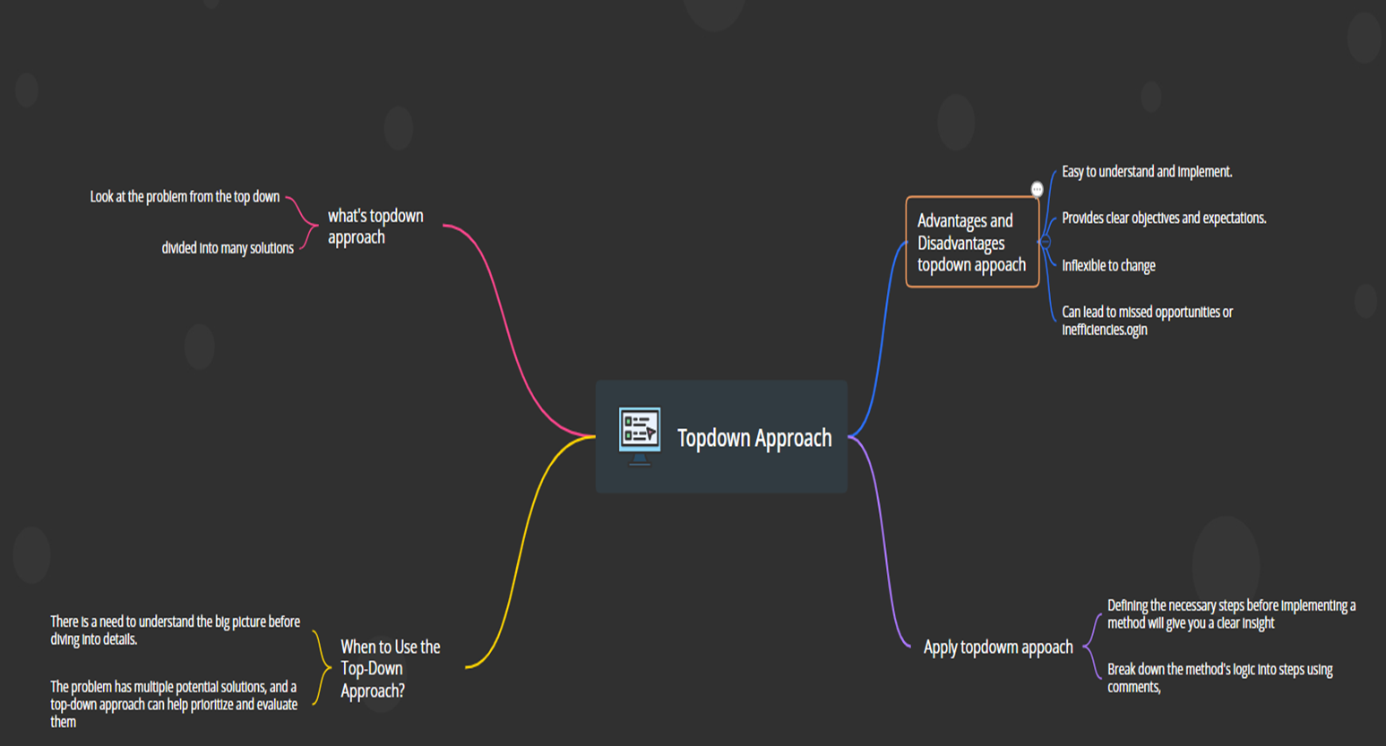
Topic What's topdowm appoach and how to apply it?
Mind Map topdiwn approach

Slide 3
Topic What's topdowm appoach and how to apply it? What's topdown approach?
01
02
03
04
Simple terms, a top-down approach is an investment strategy that selects various sectors or industries and tries to achieve a balance in an investment portfolio
The top-down approach analyzes the risk by aggregating the impact of internal failuoperationalres.
It measures the variances in the economic variables that are not explained by external macroeconomic factors. As such, this approach is simple and not data-intensive.
The top-down approach relies mainly on historical data. This approach is opposite to the bottom-up approach.

Slide 4
Topic What's topdowm appoach and how to apply it? When to Use the Top-Down Approach?
01
The problem is complex and needs to be broken down into smaller, manageable parts.
02
There is a need to understand the big picture before diving into details.
03
A clear understanding of the end goal is required before starting the project.
04
The solution can be divided into smaller subproblems that can be solved independently.
The problem has multiple potential solutions, and a top-down approach can help prioritize and evaluate them

Slide 5
Topic What's topdowm appoach and how to apply it? Advantages and Disadvantages topdown appoach
Advantages:
Disadvantages:
01
04
Easy to understand and implement.
Inflexible to change
02
05
Limited to pre-determined solutions .
Provides clear objectives and expectations.
03
06
Can result in lower motivation and participation from lower-level employees
Supports effective allocation of resources.

Slide 6
Topic What's topdowm appoach and how to apply it? Apply topdowm appoach
Attention
Interest
Desire
Stage 1: Break down the method's logic into steps using comments, as shown in the
example below.
Stage 2: Generate dependent methods, classes, enums, etc., used in stage 1. For now, just generate empty dependent methods or classes and dort bother implementing
them during this stage.
Stage 3: Once you have the code skeleton, implement dependent methods one by one
and run the unit test.

Slide 7
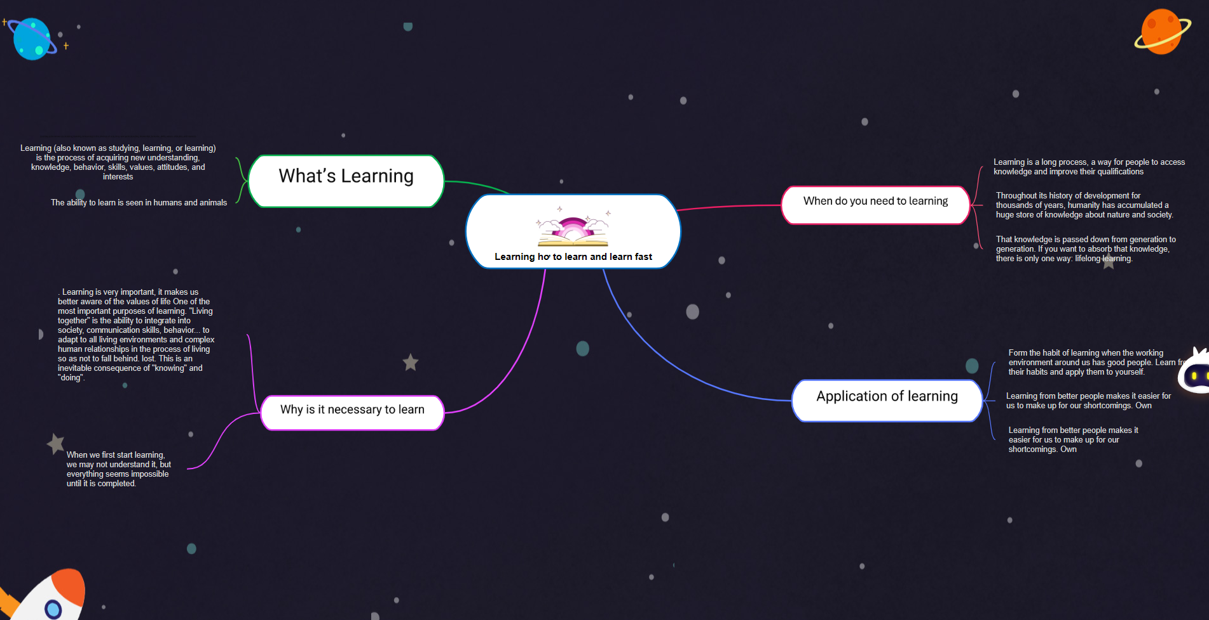
Tocpic: Learning how to learn and learn fast Mind map How to learn and learn fast

Slide 8
Learning how to learn and learn fast
What’s Learning:Learning (also known as studying, learning, or learning) is the process of acquiring new understanding, knowledge, behavior, skills, values, attitudes, and interests. The ability to learn is seen in humans and animals

Slide 9
Why is it necessary to learn
President Nelson Mandela once said “Education is the most powerful weapon you can use to change the world." You don't need to mobilize the army to destroy a country, but attack education This shows that learning not only helps you improve your knowledge and expand your mind, but also helps you contribute less to the development of the country.
When we first start learning, we may not understand it, but everything seems impossible until it is completed.
Learning is very important, it makes us better aware of the values ​​of life One of the most important purposes of learning. "Living together" is the ability to integrate into society, communication skills, behavior... to adapt to all living environments and complex human relationships in the process of living so as not to fall behind. lost. This is an inevitable consequence of "knowing" and "doing".

Slide 10

When do you need to learning
Learning is a long process, a way for people to access knowledge and improve their qualifications
Throughout its history of development for thousands of years, humanity has accumulated a huge store of knowledge about nature and society.
That knowledge is passed down from generation to generation. If you want to absorb that knowledge, there is only one way: lifelong learning.

Slide 11
Application of learning
Form the habit of learning when the working environment around us has good people. Learn from their habits and apply them to yourself.
Learning from better people makes it easier for us to make up for our shortcomings. Own
Learn knowledge from friends and colleagues. When you encounter a topic you don't know, you can open up a conversation because communication is the key to success
Learn knowledge from friends and colleagues. When you come across a topic you don't know, you can start a conversation because communication is the key to success

Slide 12
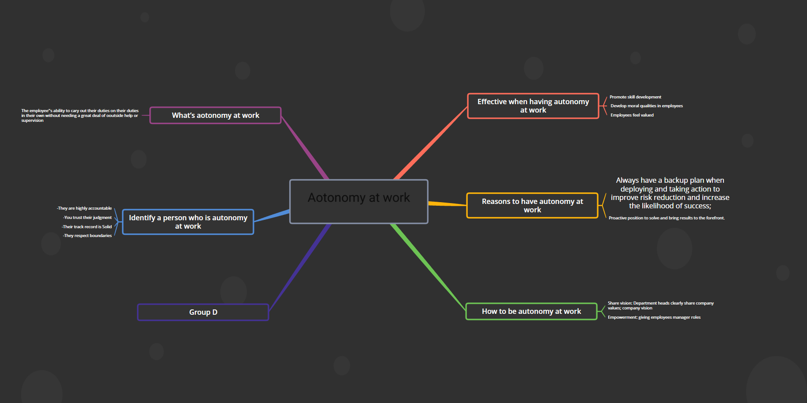
Topic:Aotonomy at work Mindmap: Aotonomy at work

Slide 13

What’s aotonomy at work
The employee''s ability to cary out their duties on their duties in their own without needing a great deal of ooutside help or supervision

Slide 14
Identify a person who is autonomy at work
-They are highly accountable -You trust their judgment -Their track record is Solid -They respect boundaries

Slide 15

Effective when having autonomy at work
-Promote skill development
-Develop moral qualities in employees
-Employees feel valued
-Increase work productivity
-Build a culture of trust
-Encourage creativity and innovation
-Engage employees to achieve better work efficiency

Slide 16
Reasons to have autonomy at work
Proactive position to solve and bring results to the forefront.
Always have a backup plan when deploying and taking action to improve risk reduction and increase the likelihood of success;

Slide 17
How to be autonomy at work
-Share vision: Department heads clearly share company values; company vision
-Empowerment: giving employees manager roles
-Set goals & implementation plans: learn about employees' ideas, understand their inner thoughts and aspirations

Slide 18
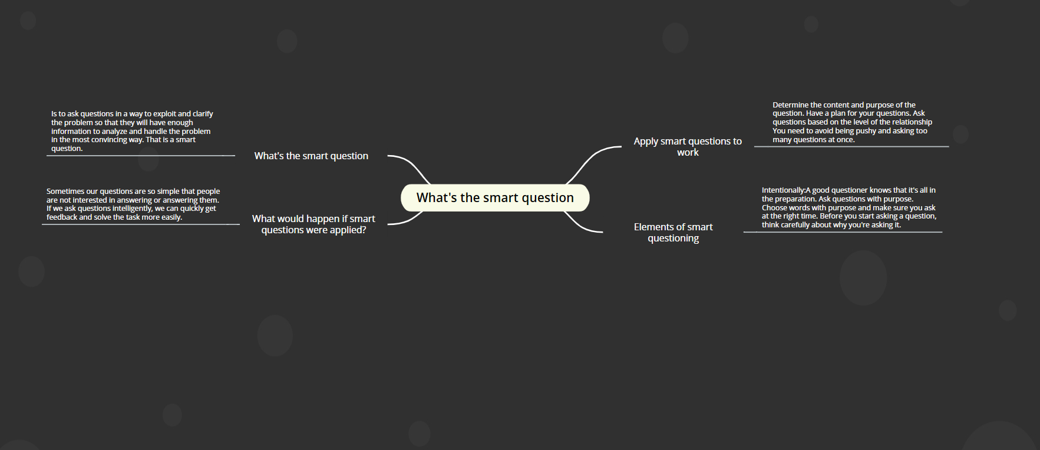
Topic: What's the smart question how to apply it on your daily basis/work
Mindmap What's the smart question how to apply it on your daily basis/work

Slide 19
What's the smart question
Is to ask questions in a way to exploit and clarify the problem so that they will have enough information to analyze and handle the problem in the most convincing way. That is a smart question.

Slide 20
What would happen if smart questions were applied?
Sometimes our questions are so simple that people are not interested in answering or answering them. If we ask questions intelligently, we can quickly get feedback and solve the task more easily.

Slide 21
Elements of smart questioning
-Intentionally:A good questioner knows that it's all in the preparation. Ask questions with purpose. Choose words with purpose and make sure you ask at the right time.
-Before you start asking a question, think carefully about why you're asking it.

Slide 22
Apply smart questions to work
-Determine the content and purpose of the question.
-Have a plan for your questions.
-Ask questions based on the level of the relationship
-You need to avoid being pushy and asking too many questions at once.

Slide 23
You can find me at:
phanduchai78@gmail.com
Any questions?
THANKS

